Slide 1
OUR STARTUP ANALYTICS PRO Insight as a capital

Slide 2
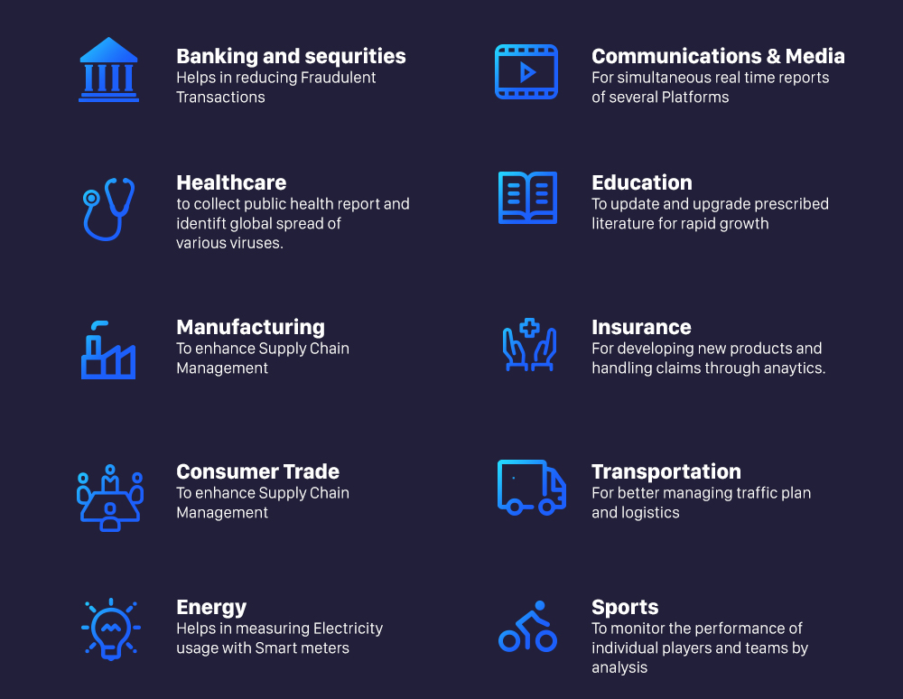
A Look on Data Generation every day
Retail stores, educational academies, online websites, tourism organizations and many more…

Slide 3
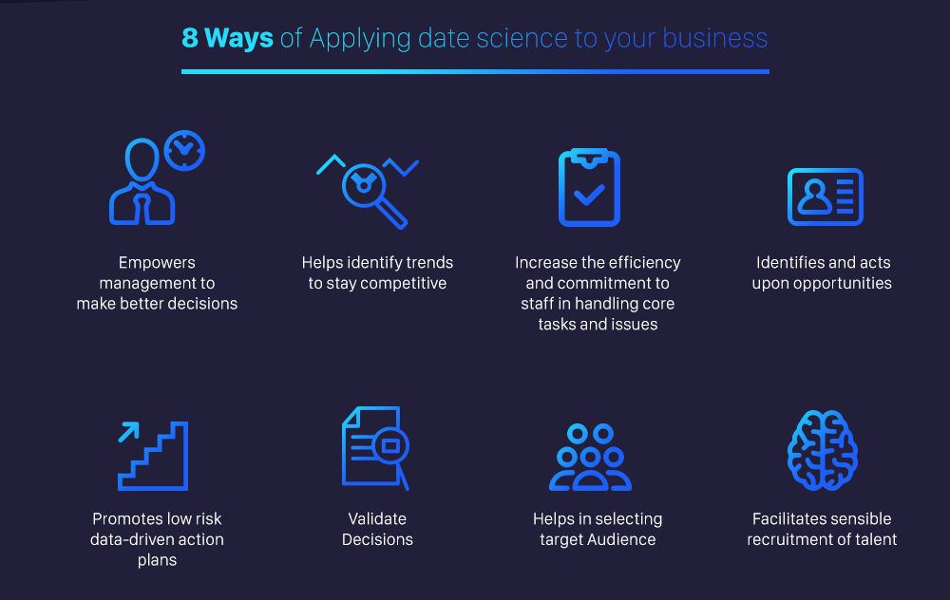
How to use this data

Slide 4
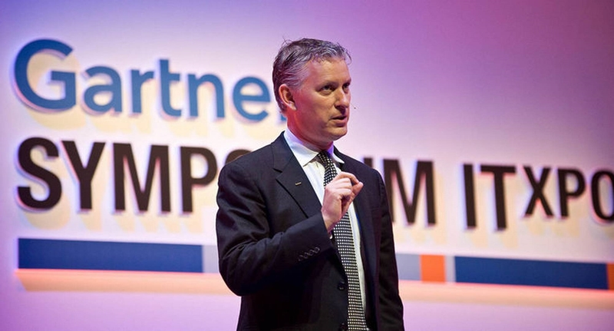
“Information is the oil of the 21st century and analytics is the combustion engine”
Peter Sondergaard
(Gartner Research)

Slide 5
My 10 points to discuss
Elevator Pitch
Problem / Need
Our Solution
Market Size
Business Model
6. Competition
7. Marketing Strategy / Plan
Team
Traction/ Projection
Needs
Capital :-
All those man-made goods which are used in further production of wealth is called as a capital.

Slide 6
1. Elevator Pitch
Short Summary of our Idea :-
we solve business problems of many organizations / Industries by providing Insights and predictions to help them taking decisions and to make good strategies of their business to gain profits. We make money by charging them with these insights and predictions.

Slide 7
Next Three points in a one go
2. Problem / Need
As this much lot of data is generating every day there is no proper way to store, use and make this data sense and meaningfull. So most of the data from some small Industries and retails remains unuseful.
3. Solution
So we use this data by performing data analysis that will draw insights for their bussiness problems and make predictions by building machinelearning models.
4. Market Size
There is a huge market for these analytics technologies in local of our current city to a global Industries across the country like retails, shopping malls to Textile Industries and Mills.

Slide 8
Next Three points in a one go
5. Business Model
This basically discuss about how we make money. As we draw insights and make predictive analysis for the clients and charge them money for that.
6. Competition
Since there is lot of demand for this technology so more and more requirement is there so competition is not a problem but we can be unique by advertise our client products along with analytics
7. Market Strategy/ Plan
Along with performing analytics and predictions we can also offer courses to students and conduct workshops with colleges and with some organizations which are sources for our advertisements

Slide 9
Next Three points in a one go
8. Team
We had a good team with all the required skills from all the required branches who have strong will power and great communication skills. Our Team is good at analytical skills which is mainly required.
9. Traction / Projections
This is about what we have achieved till now.We have great skills in data science, ML, tableau,Analytics, webdevelopment, RPA, we are youtubers also, Top 30 performer of BI, SIH winners, Worked on 30+ real time projects.
10. Needs
This is about what will be the cost and what are the requirements for this. This requires a low budget as all of our working software are open source and do not need much high configuration hardware and servers.

Slide 10

Online Courses for Students
As these are the trending technologies students show much interest in these technologies so that we can provide them online courses and can conduct workshops in colleges in this way also we can make money.

Slide 11
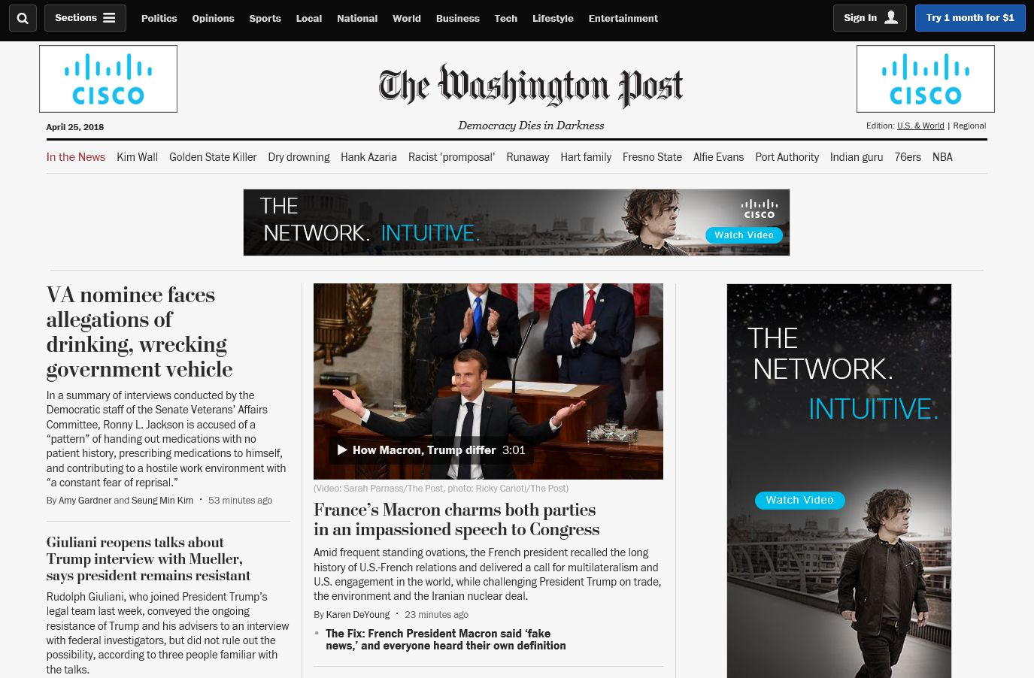
Our website
We can create a local website for people to know about the latest news of their town and use this to advertise and can charge money. So that with this we can perform analytics with the latest news and advertisements and know our target audience for us and for our clients as well.

Slide 12

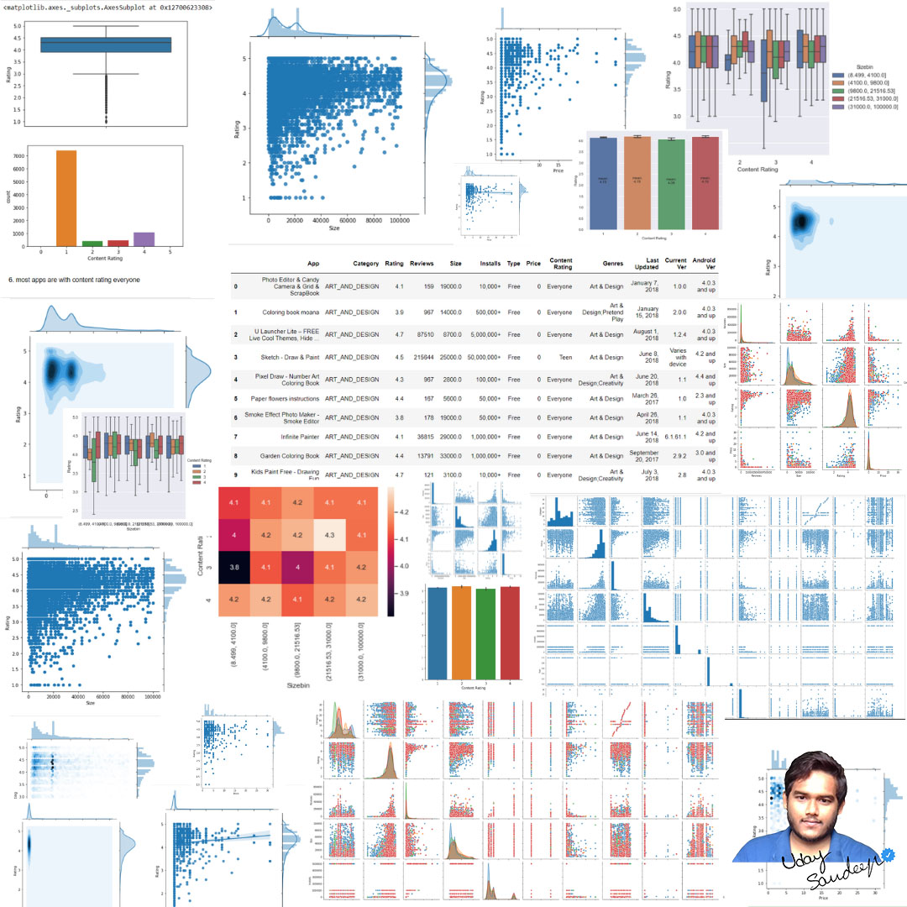
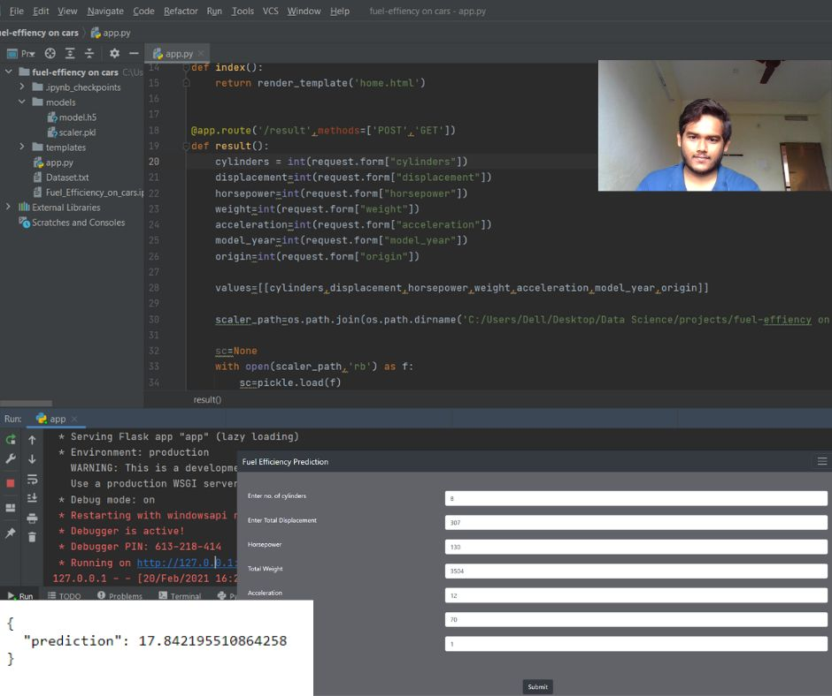
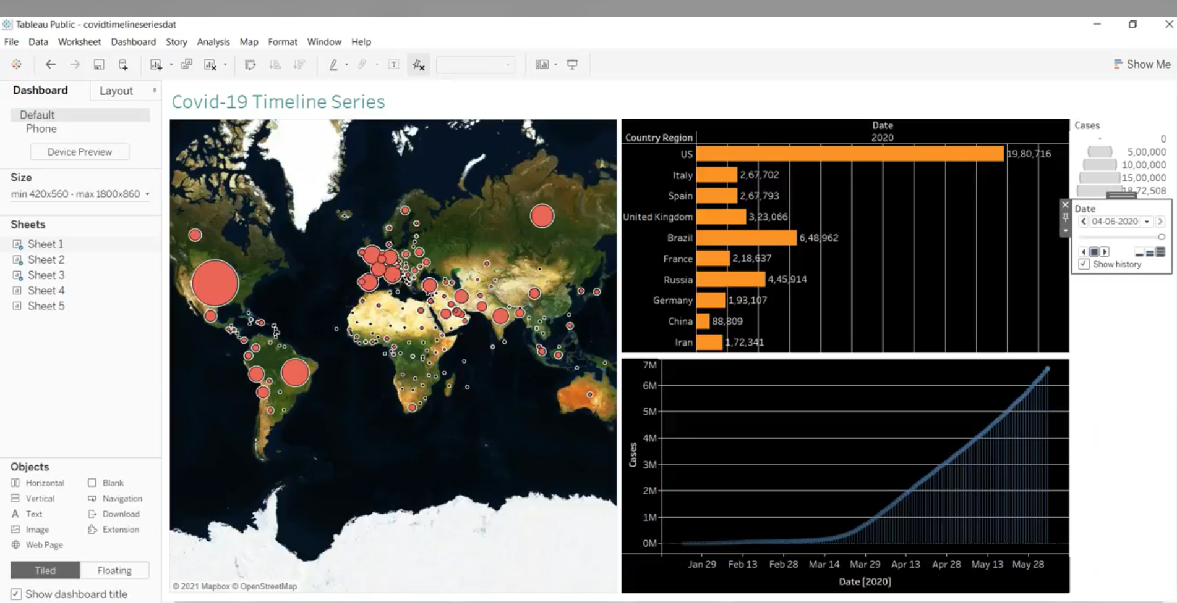
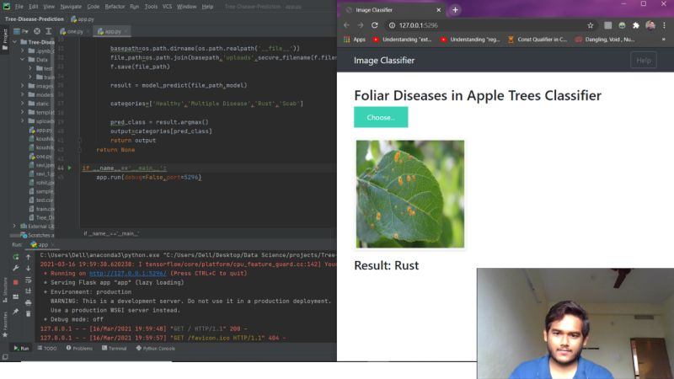
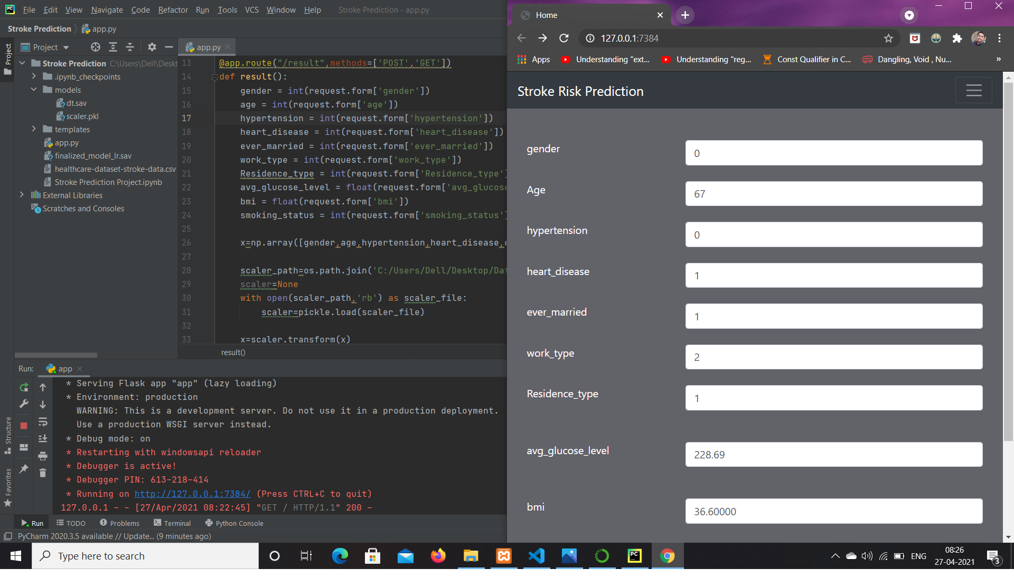
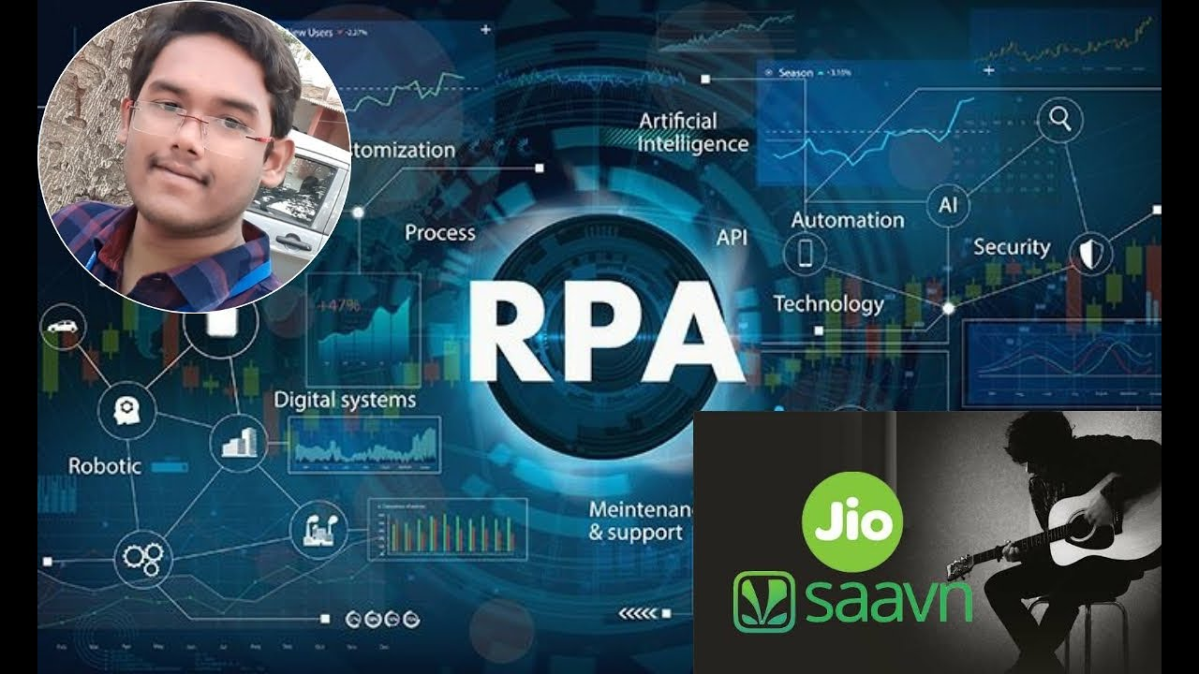
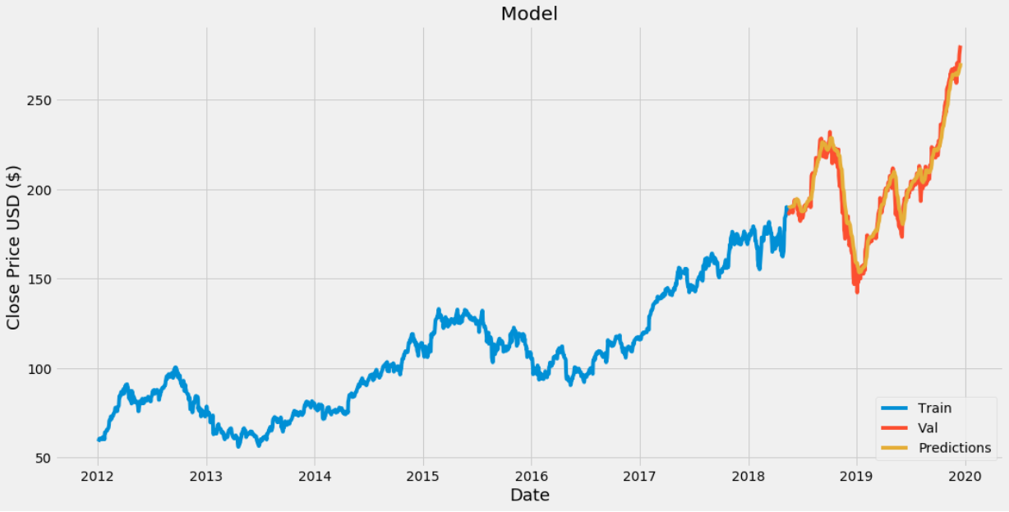
Some of my workings

Slide 13
Thankyou

Slide 14
Contact Us
Phone number :- 6303241578
Email :- udaysandeep.v9@gmail.com
LinkedIn :- udaysandeep
Github :- github.com/TechUday
Youtube :- udaysandeep
Twitter :- UdaySandeep Tech
Facebook :- udaysandeep
LinkedIn :- uday_veera

